Slide 1




Insertion Sort
By Group 7

Slide 2







INTRODUCTION
What is Insertion Sort?

Slide 3


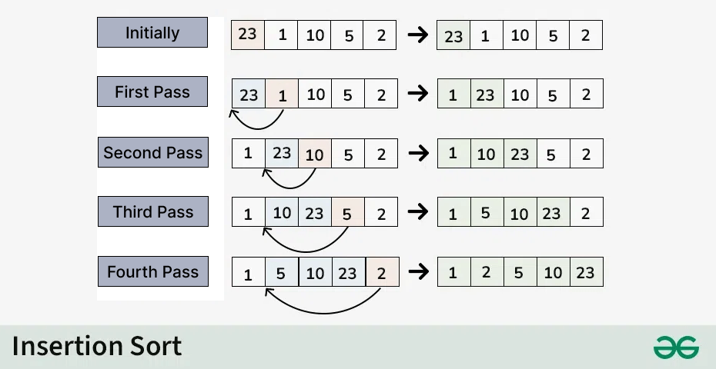

INSERTION SORT

Slide 4


APPLICATION
Small datasets - Efficient when the data set is small or nearly sorted.
Nearly sorted data: Insertion sort is very efficient when the data is nearly sorted
Online algorithms: It can be used when data arrives one at a time and needs to be sorted as it's being processed.

Slide 5


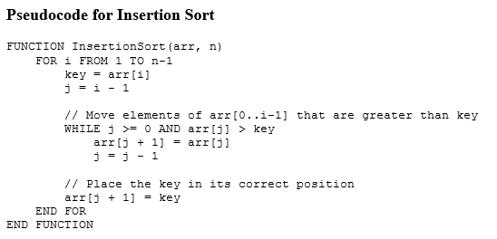
PSEUDOCODE

Slide 6


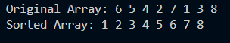
EXAMPLES

Slide 7
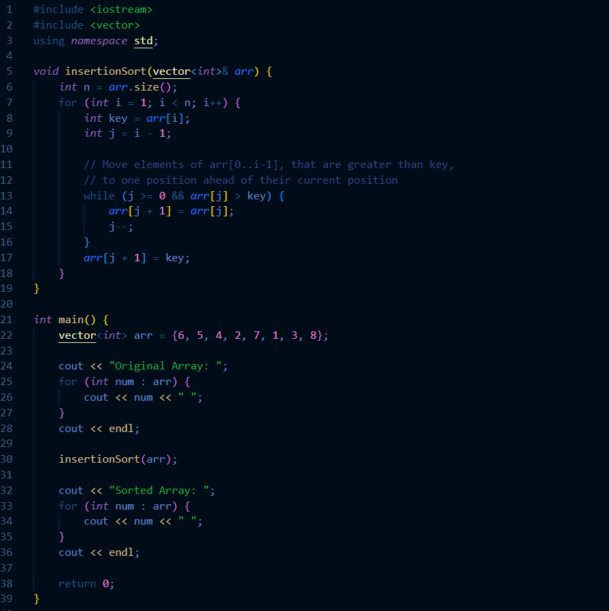
SOURCE CODE

Slide 8
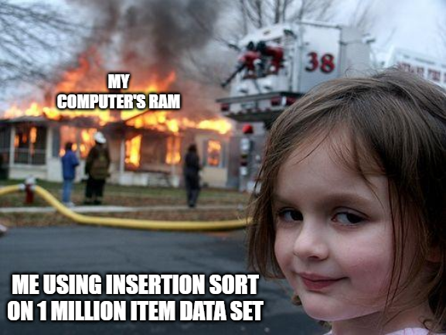


INSERTION SORT

Slide 9
REFERENCES
HTTPS://WWW.TUTORIALSPOINT.COM/DATA_STRUCTURES_ALGORITHMS/INSERTION_SORT_ALGORITHM.HTM
HTTPS://WWW.GEEKSFORGEEKS.ORG/INSERTION-SORT-ALGORITHM/
HTTPS://WWW.SOFTWARETESTINGHELP.COM/INSERTION-SORT/?FBCLID=IWZXH0BGNHZW0CMTEAAR2XKQQXOCAJS_YYDAWJGXJLFIKY0PYUFH1NSCIM9PAJS9V90HFGM1BUJCK_AEM_HKSNVGJEVNECPG9HQCMKOA

Slide 10
GROUP MEMBERS
Earl Dane Deseo
Nikko Errol S. Samson
Jose Nathaniel Rodriguez
Mike Andrei M. Gomez

Slide 11
Thank You

